Slide 1



VELOX.AI
FAST.SMART.ACCURATE.SEAMLESS
Summarise Youtube videos,pdfs and text and accelerate your learning

Slide 2


PROBLEM STATEMENT
Textbooks Overwhelm Students
Long chapters, dense text
Hard to find main ideas
Key Points Are Buried
Students miss important details
Slows learning, increases stress

Slide 3

PROJECT GOALS
AI BASED SOLUTION
GOAL 1
Summarize long and complex documents quickly.
GOAL 2
Extract key concepts and main ideas.
GOAL 3
Present information in a structured and digestible format to accelerate learning

Slide 4
METHODOLOGY
Data Source: Textbooks, PDFs, Youtube videos or raw text
Tech Stack:
Backend: LLM (DeepSeek R1) and Whisper (for audio/video transcription) and Python3
Frontend: React, Tailwind CSS
Deployment: Google Colab, flask, ngrok
Process:
Input document or video link.
AI extracts key points and concepts.
Output: Clear summary with bullet points.

Slide 5
Workflow: Backend and Frontend Communication

Slide 6
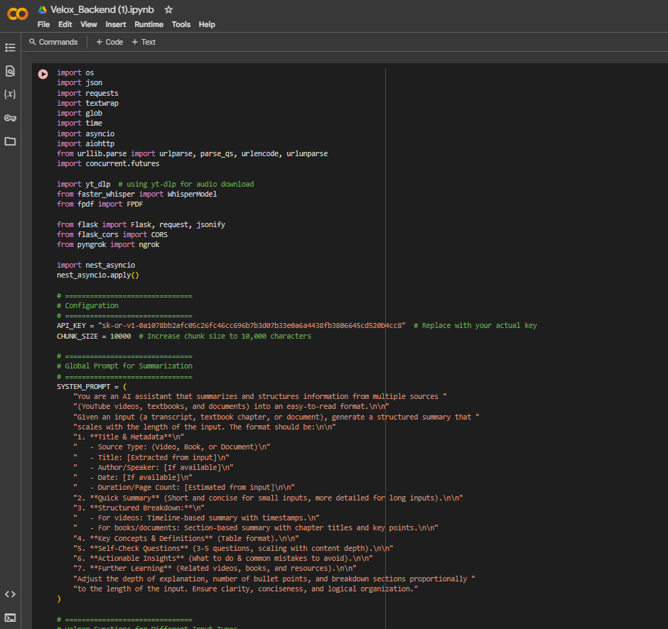
Backend Setup on Colab
Code runs in Google Colab with GPU enabled.
Flask API processes input (YouTube URL, PDF, etc.) using the modular pipeline.
Ngrok exposes a public URL for external access.

Slide 7
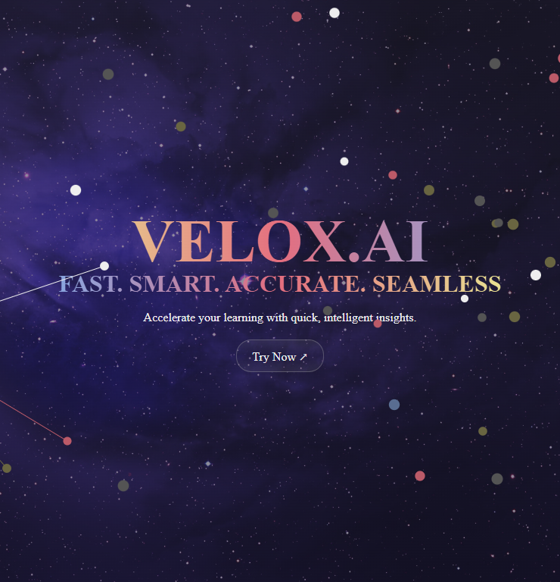
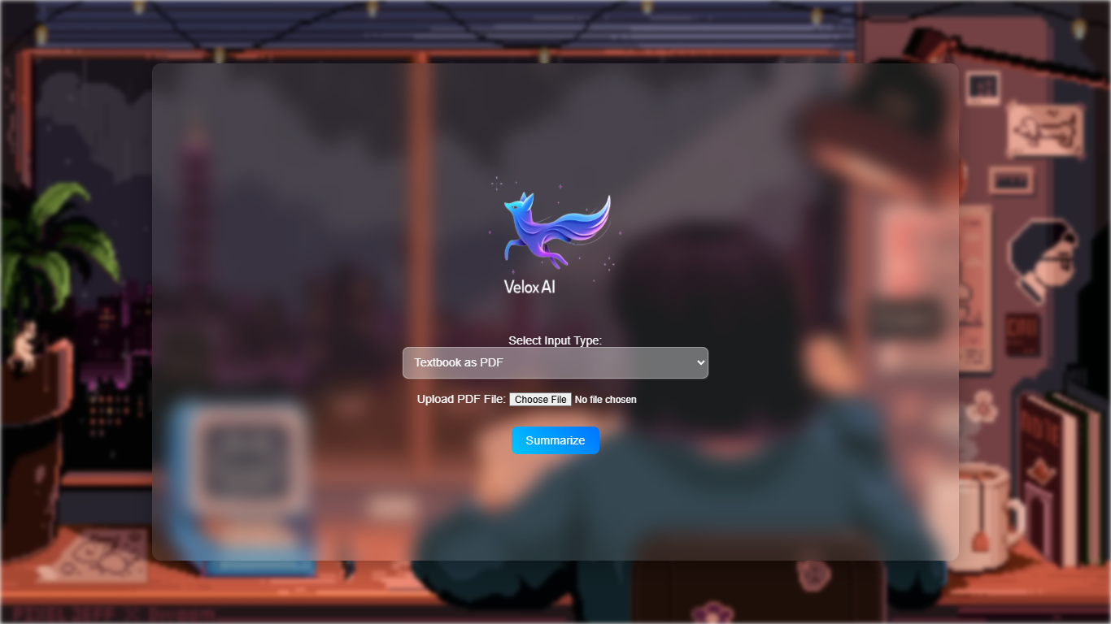
Frontend Interaction
The user navigates to the website (built with React).
The landing page features a clear interface with a dropdown for input type selection (e.g., YouTube URL, PDF, DOCX, Text).
The user selects the desired input type from the dropdown
The user clicks the "Summarize" button.
The React app builds a request payload with keys such as "input_type" and "input_source".

Slide 8
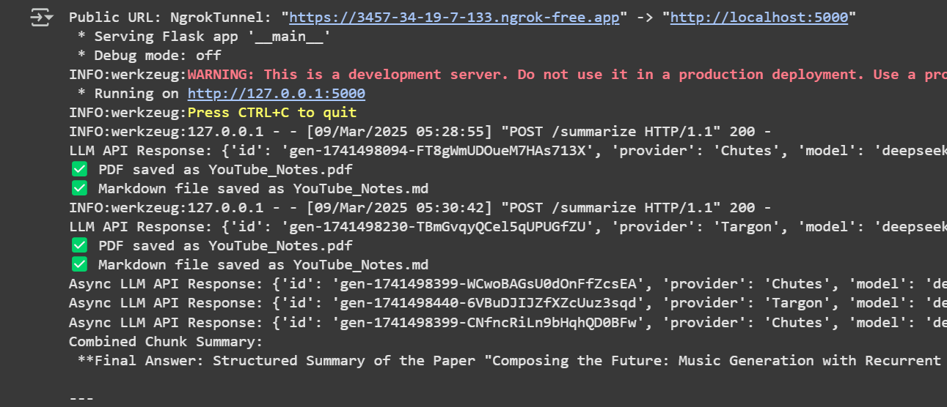
Data Processing Flow
The backend receives the request, downloads/transcribes/extracts text.
It then runs asynchronous summarization and generates a structured summary.
The summary (and additional info) is returned as a JSON response.

Slide 9
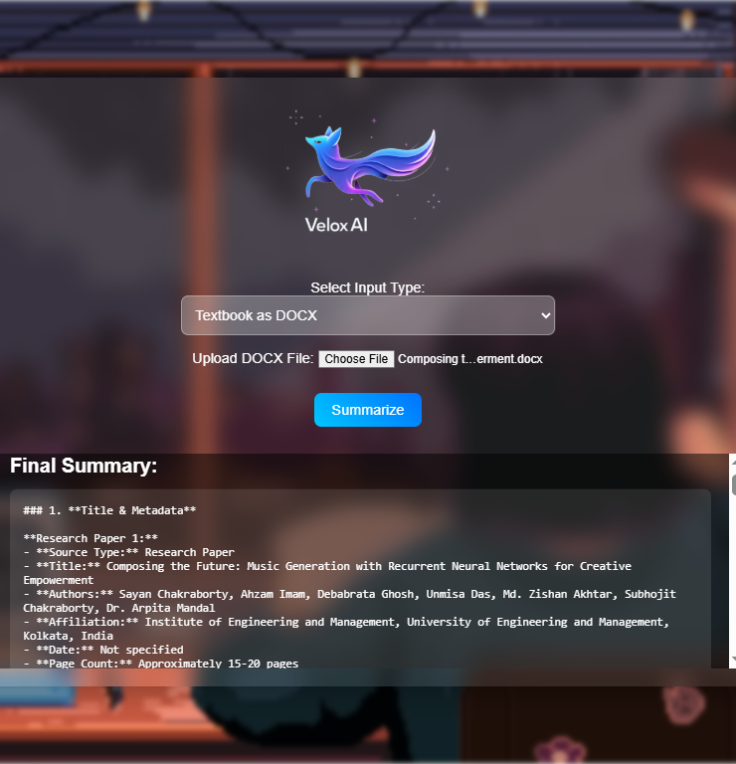
Displaying Results:
The React frontend receives the JSON response.
It extracts and displays the "final_summary" and other data to the user.

Slide 10
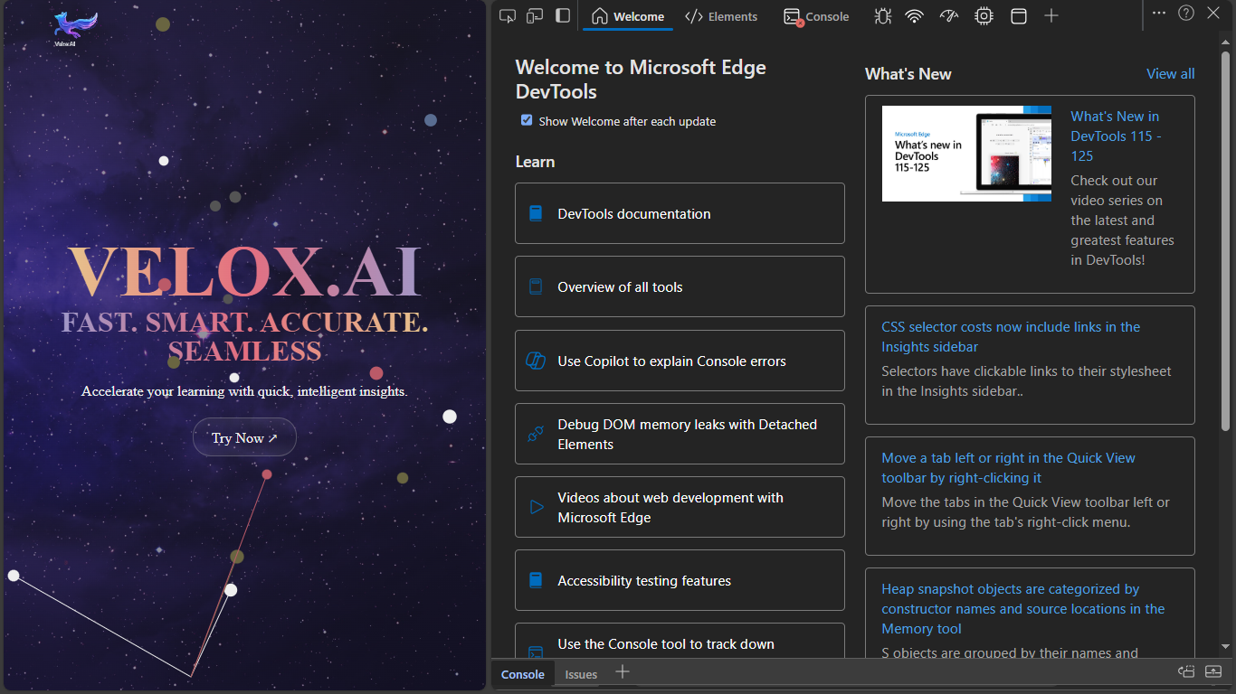
RESPONSIVE
FRONTEND BOTH WORKS PC AND MOBILE SETUP

Slide 11
Why Velox.AI Stands Out
Efficient
Intelligent
Adaptive
Fast, real-time processing of documents and videos.
DeepSeek R1 model fine-tuned for accurate summarization
Supports multiple input formats (PDF, DOCX, YouTube)

Slide 12
CONCLUSION AND FUTURE SCOPE
Conclusion:
Simplifies Content: Turns long videos and texts into clear, brief summaries.
Saves Time: Helps users quickly grasp key ideas.
Boosts Learning: Focuses on main points, reducing overload.
Multi-Source: Works with YouTube, PDFs, DOCX, and text.
Future Scope:
More Formats: Add support for more file types and languages.
Better Models: Fine-tune models for higher accuracy and faster results.
Real-Time Summaries: Implement live summarization for streaming content.
Integration: Connect with study tools for a full learning suite.

Slide 13
MADE BY
TEAM ZENITH

Slide 14
OUR TEAM
DEBABRATA GHOSH
SAYAN CHAKRABORTY
SOUVONIK BASU
SUMIT PAUL

